Slide 1
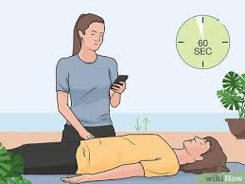
Fundamentals of Nursing(1st Stage)
Vital Signs
(2nd Part) Practice
Lecture 5
University of Basrah –College of Nursing – Fundamentals of Nursing Department

Slide 2
3- Respiratory Rate
Introduction
The mechanism of respiration exchanges oxygen (O2) and carbon dioxide (CO2) between cells of the body and atmosphere.

Slide 3
Three processes are involve in respiration:
1- Ventilation: mechanical movement of gases into and out of the lungs.
2- Diffusion: movement of O2 and CO2 between the alveoli and RBCs.
3- Perfusion: distribution of RBCs to and from the pulmonary capillaries.

Slide 4
The nurse directly assesses ventilation by observing:
Rate
Depth
Rhythm of respiratory movement.
accurate assessment of respiration depends on recognizing normal thoracic and abdominal movement.

Slide 5
On inspiration diaphragm contracts, causing abdominal organs to move downward and forward, thereby increasing vertical size of the chest cavity. And the same time the ribs lift upward and outward and the sternum lifts outward to aid the transverse expansion of the lungs.

Slide 6
On expiration the diaphragm relaxes upward, the ribs and sternum return to their relaxed position, and the abdominal organs return to their original position.

Slide 7
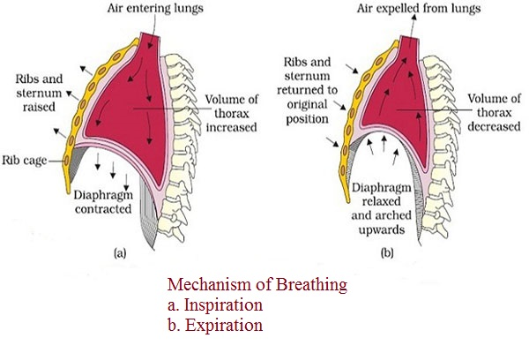

Slide 8
Normal Range of respiratory rate (12-20) breath per minute or cycle per minute

Slide 9
Alterations in breathing pattern
Description | Alteration
Rate of breathing is regular but abnormally slow(less than 12 breaths per minute). | Bradypnea
Rate of breathing is regular but abnormally rapid(greater than 20 breaths per minute). | Tachypnea
Respiration are increased in depth. Occurs normally during exercise. | Hyperpnea

Slide 10
Rate and depth of respirations increase. | Hyperventilation
Respiratory rate is abnormally low, depth of ventilation may be depressed | Hypoventilation
Respiration cease for several seconds. persistent cessation results in respiratory arrest. | Apnea
Respirations are abnormally deep but regular. Common in diabetic ketoacidosis. | Kussmaul’s respiration

Slide 11
EQUIPMENTS
1-Wrist watch
2-Pen, Vital signs flow sheet.

Slide 12
Assessment
1- Assess risk factors of respiratory alterations:
Fever
Pain and anxiety
Diseases of chest wall or muscles
Presence of abdominal incisions
Respiratory infection
Head injury with damage to brainstem
Anemia

Slide 13
2- Assess for signs and symptoms of respiratory alterations such as :
Bluish or cyanotic appearance of nail beds, lips, mucous membranes, and skin
Restlessness, irritability, confusion, reduced level of consciousness
Pain during inspiration
Use of accessory muscles
Inability to breathe spontaneously
Sputum production

Slide 14
3- Assess for factors that influence the character of respirations:
Exercise
Anxiety
Acute pain
Smoking
Medication
Body position

Slide 15
Nursing Diagnosis
Ineffective airway clearance
Ineffective breathing pattern
Impaired gas exchange
Impaired spontaneous ventilation
Activity intolerance

Slide 16
Planning
Expected outcomes following completion of procedure:
Respiratory rate is within acceptable range
Respirations are regular and of normal depth

Slide 17
Implementation
1- Draw curtain around bed and/or close door.
2- Perform hand hygiene.
3- Be sure that patient in lying position with the head of the bed elevated to 45 degrees and chest is visible. If necessary, move bed linen or gown.
4- Place patient’s arm in relaxed position across abdomen or lower chest or place your hand directly over patient’s upper abdomen.
5- Observe complete respiratory cycle (one inspiration and one expiration).

Slide 18
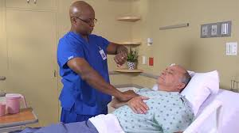

Slide 19
6- After observing cycle, look at second hand of watch and begin to count rate.
7- If rhythm is regular, count number of respirations in 30 seconds and multiply by 2. If rhythm is irregular, less than 12, or greater than 20, count for 1 full minute.
8- Note depth of respirations by observing degree of chest wall movement while counting rate.
9- Replace bed linen and patient’s gown
10- Perform hand hygiene.

Slide 20
Evaluation
Compare respirations with patient’s previous baseline and usual rate, rhythm, and depth.

Slide 21
4- Measuring Body Temperature
Body temperature: is the difference between the amount of heat produced by the body processes and the amount of heat lost to the external environment.

Slide 22
1-The core temperature, or temperature of the deep body tissues is under control of the hypothalamus and is maintained within a narrow range.
2-Skin or body surface temperature rises and falls as the temperature of the surrounding environment changes and can fluctuate dramatically.

Slide 23
Surface site | Core site
1-Skin 2- Oral cavity 3- Axillary | 1-Rectum 2- Tympanic membrane 3- Esophagus 4- Pulmonary artery 5- Urinary bladder

Slide 24
Normal range of body temperature
(36 - 38 ) centegrade or celsius

Slide 25
Fever or Pyrexia: Body temperature more than 38c.
Hyperpyrexia: Body temperature more than 40c.
Hypothermia: Body temperature less than 36c.

Slide 26
Notes
Person with normal body temperature called Afebrile
Person with High body temperature called Febrile.
Rectal temperatures are usually 0.5 c higher than oral temperatures.
Axillary and Tympanic temperatures are usually
0.5 c lower than oral temperatures.
Sites reflecting core temperature are more reliable indicators of body temperature than sites reflecting surface temperature.

Slide 27
Advantages and limitations of select temperature measurement site.
1-Oral
Advantages
Easily accessible, requires no position change.
Comfortable for client.
Provide accurate surface temperature reading.
Reflect rapid change in core temperature.
Shown to be reliable route to measure temperature in intubated client.

Slide 28
Limitations
Caused delay in measurement if client recently ingested hot, cold fluids or foods, smoked, or receive oxygen.
Risk of body fluid exposure
Should not be used for( contraindication):
Clients who have had oral surgery
Trauma in mouth
History of epilepsy
Infants, small children
Confused, unconscious or uncooperative clients
Vomiting
Severe cough
Mouth breathing

Slide 29
2-Axilla
Advantages
Safe and inexpensive , can be used with newborns
and unconscious clients
Limitations
Long measurement time.
Requires continuous positioning by nurse.
Requires exposure of thorax , which can result in temperature loss especially in newborns.
Not recommended to detect fever in infants and young children.

Slide 30
3-Rectal
Advantages
Argued to be more reliable when oral temperature cannot be obtained.
Limitations
Requires positioning and may be source of client embarrassment and anxiety.
Risk of body fluid exposure.
Requires lubrication.
Should not be used for clients with diarrhea, bleeding, rectal surgery, rectal disorder.

Slide 31
4-Tympanic membrane
Advantages
Easily accessible site.
Can be used for clients with tachypnea without affecting breathing.
Very rapid measurement (2-5sec.)
Unaffected by oral intake or food or fluid or smoke.
Can be used in newborns to reduce infant handling and heat loss.

Slide 32
Limitations
Requires removal of hearing aids before measurement.
Does not accurately measure core temperature changes during and after exercise.
Should not be used with clients who have had surgery of the ear or tympanic membrane.

Slide 33
5- Skin
Advantages
1- Inexpensive
2- Provides continuous reading
3- Safe and non invasive
4- Used for neonates
Limitations
1- Measurement lags behind other sites during temperature changes especially during hyperthermia.
2- Impaired adhesion from diaphoresis or sweat.
3- Affected by environmental temperature.
4- Cannot be used for patients with allergy to adhesive.

Slide 34
EQUIPMENT
1-Appropriate thermometer.
2- Soft tissue.
3- Lubricant ( For rectal measurements only ).
4- Pen, vital signs flow sheet or record form.
5- Disposable gloves, plastic thermometer sleeves.

Slide 35
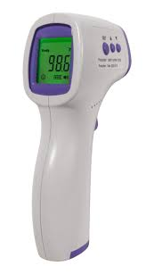
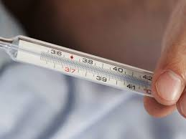

Slide 36
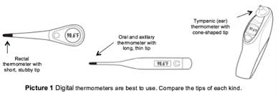

Slide 37
Nursing Diagnosis
Hyperthermia
Hypothermia
Ineffective thermoregulation
Risk for imbalanced body temperature

Slide 38
Procedure
Oral temperature
Perform hand hygiene, applying clean gloves.
Ask patient to open mouth; gently place thermometer probe under tongue in posterior sublingual pocket lateral to center of lower jaw
Ask patient to hold thermometer probe with lips closed
Leave thermometer probe in place until audible signal indicates completion and patient’s temperature appears on digital display, remove thermometer probe from under patient’s tongue.
Push ejection button on thermometer probe stem to
discard plastic probe cover into appropriate receptacle.
Remove gloves and dispose in appropriate receptacle and perform hand hygiene.

Slide 39
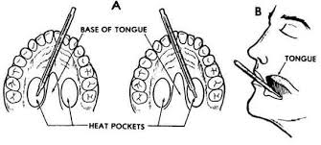

Slide 40
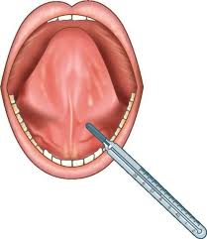

Slide 41
Rectal temperature
1- Draw curtain around bed and/or close room door.
2- Assist patient to side-lying or Sims’ position with upper leg
flexed. Move aside bed linen to expose only anal area. Keep patient’s upper body and lower extremities covered with sheet or blanket.
3- Perform hand hygiene and apply clean gloves. Cleanse anal region when feces and/or secretions are present. Remove soiled gloves and reapply clean gloves.
4- Remove thermometer pack from charging unit. Attach rectal thermometer probe stem (red tip) to thermometer unit. Grasp top of probe stem, being careful not to apply pressure on ejection button.
5- Using a single use package, squeeze a liberal amount of lubricant on tissue. Dip probe cover of thermometer, blunt end, into lubricant, covering 2.5 to 3.5 cm for adult.

Slide 42
6- With non dominant hand separate patient’s buttocks to expose anus. Ask patient to breathe slowly and relax.
7- Gently insert thermometer into anus in direction of umbilicus 3.5 cm for adult. Do not force thermometer.
8- If you feel resistance during insertion, withdraw immediately. Never force thermometer.
9-hold thermometer probe in place until audible signal indicates completion and patient’s temperature appears on digital display; remove thermometer probe from anus.
10- Assist patient in assuming a comfortable position, Remove and dispose of gloves in appropriate receptacle. Perform hand hygiene.

Slide 43
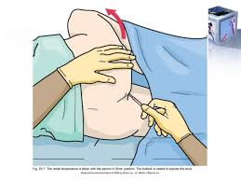

Slide 44
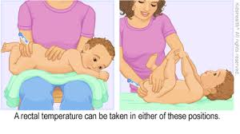

Slide 45
Axillary temperature
1- Draw curtain around bed and/or close room door.
2- Assist patient to supine or sitting position. Move clothing or
gown away from shoulder and arm.
3- Raise patient’s arm away from torso. Inspect for skin
lesions and excessive perspiration; if needed, dry axilla.
4- Insert thermometer probe into center of axilla, lower arm over probe, and place arm across patient’s chest.

Slide 46
5- Once thermometer probe is positioned, hold it in place until audible signal indicates completion and patient’s temperature appears on digital display; remove thermometer probe from axilla.
6- Assist patient in assuming comfortable position, replacing linen or gown.
7- Perform hand hygiene.

Slide 47
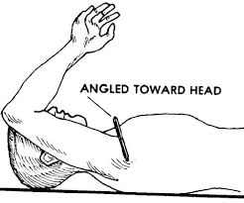

Slide 48
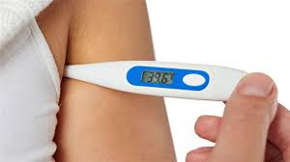

Slide 49
Tympanic membrane temperature
Assist patient in assuming comfortable position with head turned toward side, away from you. If patient has been lying on one side, use upper ear. Obtain temperature from patient’s right ear if you are right- handed. Obtain temperature from patient’s left ear if you are left-handed.
Note if there is an obvious presence of cerumen (earwax) in patient’s ear canal.
Fit speculum tip snug in canal, pointing toward the nose.
Once thermometer positioned, press scan button on handheld unit. Leave speculum in place until audible signal indicates completion and patient’s temperature appears on digital display.
Help patient assume a comfortable position.
Perform hand hygiene.

Slide 50
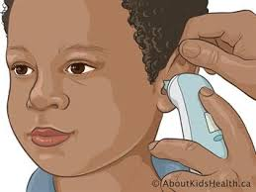

Slide 51
THANKS

